Slide 1

SMART DASHBOARD FOR PENGUIN DATA INSIGHTS AND PREDICTION
MASTER OF COMPUTER APLICATIONS 2023-2025
Supervisor: Mr. M.Mohammed Jalaluddin
Assistant Professor
Department of Computer Applications
Student Name : Mohamed Safeek Rahman S S
RRN:230282601072
DEPARTMENT OF COMPUTER APPLICATIONS

Slide 2
ABSTRACT
The "Data Visualization Dashboard for Penguin Dataset Using Python" is an interactive application designed to explore, visualize, and predict penguin species using machine learning. Developed with Streamlit, the project integrates data analysis, visualization, and predictive modelling into a seamless, user-friendly interface.
It leverages the Palmer Penguins dataset, a reliable alternative to the Iris dataset, to demonstrate practical applications of data science in ecological studies.
The dashboard provides users with tools to explore raw data and uncover patterns through interactive visualizations. Relationships between features such as bill length, bill depth, flipper length, body mass, and island habitats are displayed dynamically, allowing users to gain insights into the underlying trends within the dataset.
This promotes an intuitive understanding of how various features contribute to distinguishing penguin species.
DEPARTMENT OF COMPUTER APPLICATIONS

Slide 3
OBJECTIVE
The Penguin Dataset Visualization Dashboard is an interactive platform designed to explore, analyze, and predict penguin species using the Palmer Penguins dataset. It provides a user-friendly interface to visualize relationships between features such as bill length, flipper length, body mass, and species distribution.
The application uses a Random Forest Classifier to predict penguin species in real time based on user inputs like physical measurements and habitat data. It dynamically processes inputs, delivering predictions and probabilities while demonstrating the power of machine learning in ecological data analysis.
This project serves as an educational tool for understanding data science concepts, including preprocessing, feature engineering, and model training, while showcasing machine learning applications in biodiversity conservation and ecological research. By combining hands-on exploration with an intuitive interface, it enhances user engagement and highlights the importance of data-driven decision-making in environmental studies.
DEPARTMENT OF COMPUTER APPLICATIONS

Slide 4
LITERATURE SURVEY
Machine Learning in Ecology Machine learning algorithms like decision trees and Random Forest are used to analyze ecological data, helping with species classification and ecosystem predictions.
Palmer Penguins Dataset The Palmer Penguins dataset offers practical insights for machine learning, with features like bill length and species, ideal for classification tasks.
Data Visualization Tools like scatter plots and histograms help visualize ecological data, revealing patterns and trends crucial for understanding species and habitats.
Random Forest Classifier Random Forest is a powerful tool for classifying species based on physical traits, providing accurate predictions in ecological studies.
Streamlit for Web Applications Streamlit enables the creation of interactive dashboards for real-time data analysis and machine learning model interaction.
DEPARTMENT OF COMPUTER APPLICATIONS

Slide 5
EXISTING SYSTEM
Existing systems for ecological data analysis are often fragmented, relying on standalone tools that don’t integrate seamlessly. These systems typically involve manual processes, making them time-consuming and inaccessible to non-technical users. Common tools like Excel, SPSS, and statistical software require extensive knowledge of data analysis and statistical methods, which can be intimidating for those without technical expertise. Many visualization platforms, such as Tableau or basic Python libraries, offer static visualizations and lack real-time interactivity or predictive modeling capabilities.
Machine learning tools like Python’s scikit-learn also present challenges, as they require programming knowledge and data preprocessing skills. Additionally, current systems are often disjointed, with users needing to switch between different software for data collection, visualization, and model building. This fragmented workflow complicates the process and reduces efficiency, making it difficult for users to integrate data analysis steps and perform comprehensive ecological analysis. As a result, these systems are less accessible to a broader audience, limiting their practical use.
DEPARTMENT OF COMPUTER APPLICATIONS

Slide 6
PROPOSED SYSTEM
The proposed system addresses the limitations of existing platforms by integrating data visualization, machine learning, and user interactivity into a single platform using Python and Streamlit. It simplifies the entire data analysis pipeline, allowing users to visualize relationships between features and input custom data for real-time predictions. The system enables users to explore trends, test hypotheses, and receive species predictions based on a pre-trained machine learning model, such as Random Forest, without needing programming expertise. Unlike fragmented systems, it combines data preparation, visualization, modeling, and interaction into one unified, user-friendly platform, making it accessible for educational and research purposes in ecological data analysis.
DEPARTMENT OF COMPUTER APPLICATIONS

Slide 7
METHODOLOGY
1. Data Collection and Cleaning
The Palmer Penguins dataset is collected and cleaned to remove inconsistencies and missing values. The cleaning process includes handling null or erroneous entries, standardizing data formats, and ensuring all features are in a usable form for analysis.
2. Feature Preparation
Relevant features such as bill length, flipper length, body mass, and habitat-related variables (island and sex) are selected. Categorical data is encoded using one-hot encoding to convert them into numerical values, enabling the data to be used effectively by machine learning models.
3. Model Training
A Random Forest classifier is trained on the prepared dataset. This model is well-suited for classification tasks, learning patterns and relationships in the data to predict penguin species (Adelie, Chinstrap, Gentoo).
DEPARTMENT OF COMPUTER APPLICATIONS

Slide 8
METHODOLOGY
4. Application Development
Streamlit is used to develop an interactive web-based application. The application displays visualizations of the data and allows users to input custom data points, such as penguin measurements, to receive real-time species predictions using the trained Random Forest model.
5. Integrated Platform
The final system combines data visualization, model training, real-time data input, and prediction into one cohesive platform. This integrated approach ensures an intuitive and interactive user experience, making it accessible even to users with minimal technical or statistical knowledge.
DEPARTMENT OF COMPUTER APPLICATIONS

Slide 9
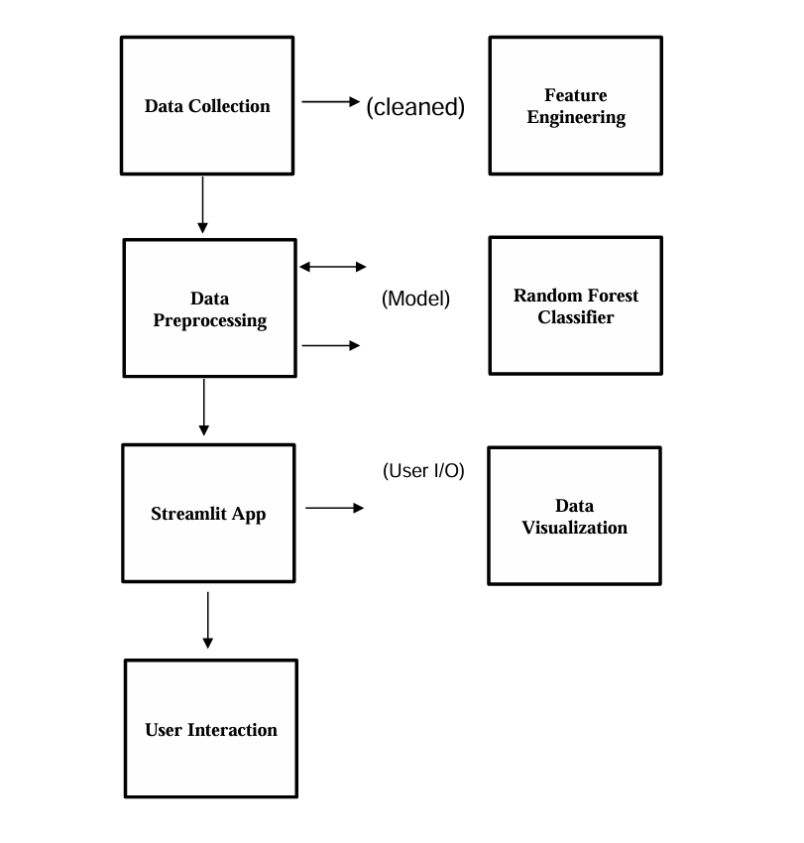
ARCHITECTURE DIAGRAM
DEPARTMENT OF COMPUTER APPLICATIONS

Slide 10
IMPLEMENTATION
The implementation of the system involves transitioning from the old system to the new, utilizing Python for the design and development. The project uses the Palmer Penguins dataset, which contains ecological data about three species of penguins: Adelie, Chinstrap, and Gentoo. This dataset includes features such as bill length, flipper length, body mass, sex, and island.
The first step is data preprocessing, where the dataset is cleaned by handling missing values. Numerical missing values are imputed with the median, while categorical columns with missing data are dropped. The categorical features, including species, island, and sex, are then encoded into numerical values using label encoding. Feature scaling is generally not required for tree-based models like Random Forest but may be applied in specific cases.
DEPARTMENT OF COMPUTER APPLICATIONS

Slide 11
IMPLEMENTATION
Next, the dataset is split into training and testing data. The training set, typically comprising 80% of the data, is used to train the Random Forest model, allowing it to learn patterns between features and species labels. The remaining 20% of the data is set aside as the testing data, helping evaluate the model's performance by comparing predictions with actual labels. This ensures that the model is generalizable and not overfitting to the training data. Cross-validation techniques may also be used to validate the model’s effectiveness.
DEPARTMENT OF COMPUTER APPLICATIONS

Slide 12
MODULES
Data Analysis
Descriptive Analytics
Predictive Analytics
DEPARTMENT OF COMPUTER APPLICATIONS

Slide 13
MODULES
1.Data Analysis
The Data Analysis phase involves preparing the Palmer Penguins dataset for machine learning. The data is loaded using pandas and split into features (X) and target (y). Categorical features like island and sex are encoded using one-hot encoding, and the target species is converted into integer labels. This preprocessing ensures the data is ready for model training.
2.Descriptive Analytics
Descriptive Analytics summarizes key features of the dataset, using scatter plots to explore relationships between variables like bill length and body mass, and identifying outliers or missing values.
3.Predictive Analytics
Predictive Analytics uses a Random Forest Classifier to predict penguin species, providing both species predictions and confidence probabilities.
DEPARTMENT OF COMPUTER APPLICATIONS

Slide 14
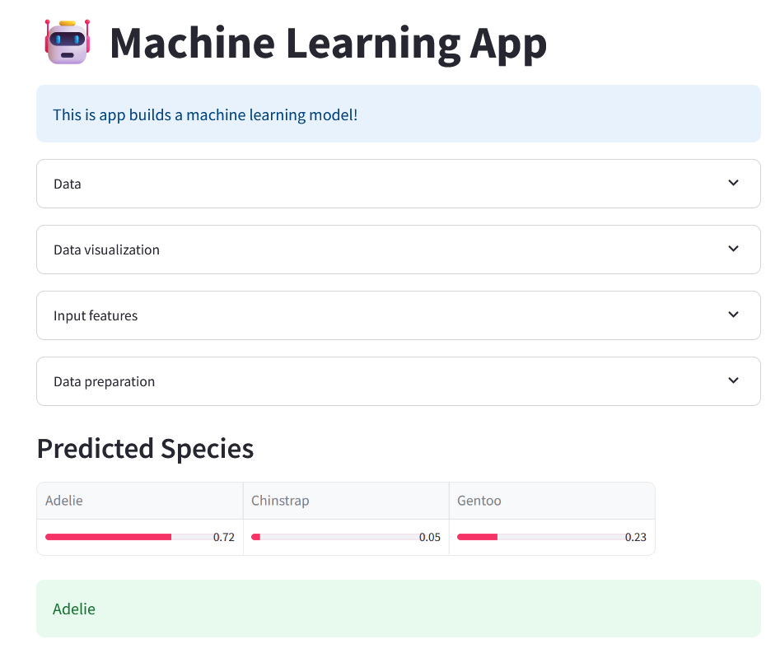
SCREENSHOTS
DEPARTMENT OF COMPUTER APPLICATIONS

Slide 15
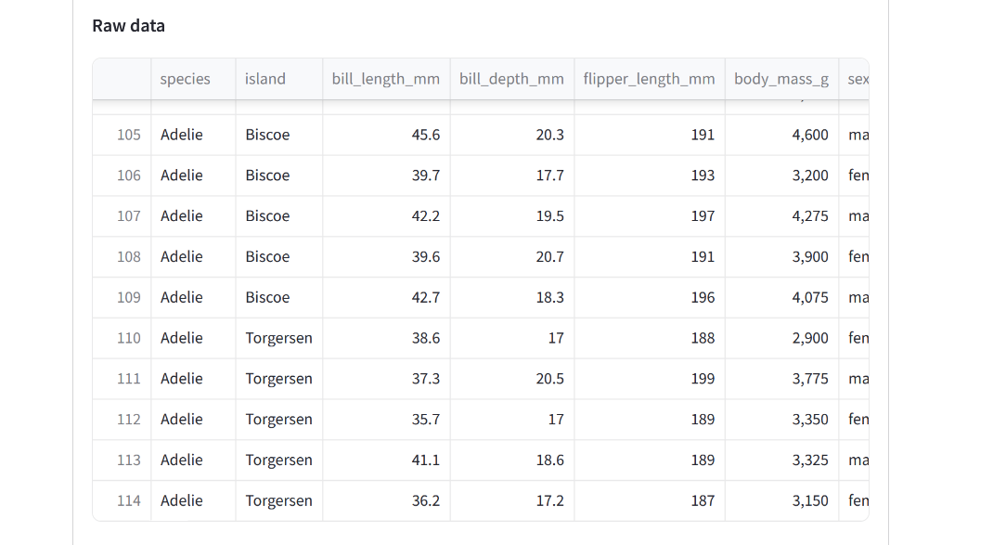
SCREENSHOTS
DEPARTMENT OF COMPUTER APPLICATIONS

Slide 16
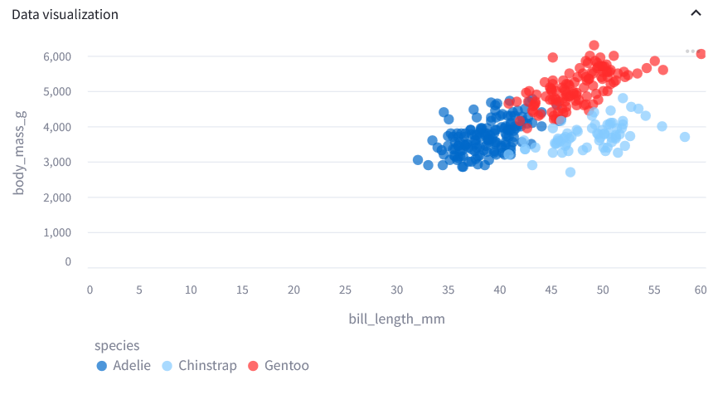
SCREENSHOTS
DEPARTMENT OF COMPUTER APPLICATIONS

Slide 17
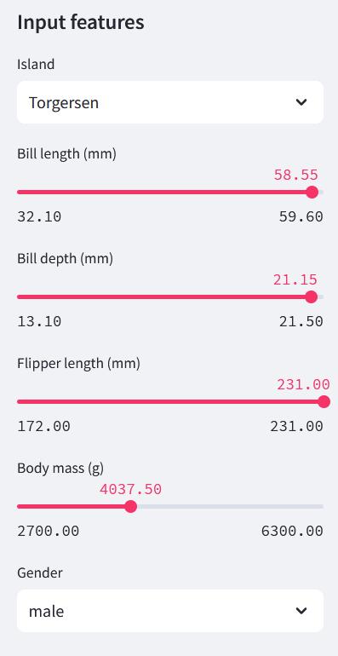
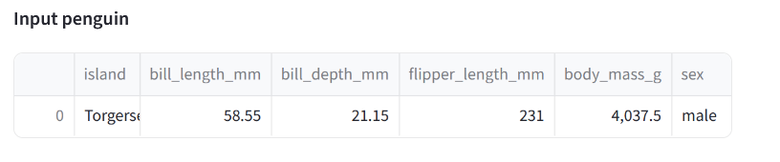
SCREENSHOTS
DEPARTMENT OF COMPUTER APPLICATIONS

Slide 18
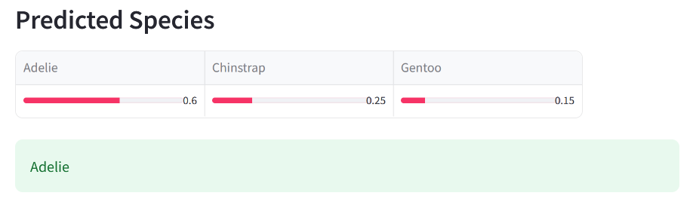
SCREENSHOTS
DEPARTMENT OF COMPUTER APPLICATIONS

Slide 19
CONCLUSION AND FUTURE SCOPE
Conclusion:
The analysis of the penguin dataset reveals important insights into the physical traits and habitat preferences of different species, highlighting the relationship between morphology and environment. It provides a foundation for further ecological studies and conservation efforts, particularly in understanding how environmental factors influence penguin populations. This dataset is crucial for identifying vulnerable species and promoting biodiversity preservation. Future enhancements could include integrating climate data and exploring deeper ecological and evolutionary patterns.
Future enhancements
Future enhancements to the penguin dataset and analysis could include expanding the species coverage to include more geographic regions, providing a broader understanding of penguin adaptations. Incorporating detailed environmental data like sea temperature, ice coverage, and food supply would offer deeper insights into how penguins respond to climate change. Longitudinal data could improve predictions on population dynamics and survival rates. Additionally, integrating genetic data could reveal evolutionary trends and enhance understanding of penguin adaptations, supporting ecological studies and conservation efforts.
DEPARTMENT OF COMPUTER APPLICATIONS

Slide 20
REFERENCE
➢ M. Allaire et al., "Interactive web applications using R with Shiny," Journal of Statistical Software, vol. 87, no. 1, pp. 1–39, 2018
View at: Publisher Site | Google Scholar
A. Developer, "Building machine learning apps with Streamlit: A hands-on approach," Open Source Python Projects, 2024
View at: Publisher Site | Google Scholar
M. Wilke, "Streamlined workflows for creating data visualizations using ggplot2," R Journal, vol. 10, no. 2, pp. 378–396, 2018.
View at: Publisher Site | Google Scholar
T. Chen and C. Guestrin, "XGBoost: A scalable tree boosting system," Proceedings of the 22nd ACM SIGKDD International Conference on Knowledge Discovery and Data Mining, pp. 785–794, 2016.
View at: Publisher Site | Google Scholar
DEPARTMENT OF COMPUTER APPLICATIONS

Slide 21

DEPARTMENT OF COMPUTER APPLICATIONS

